Slide 1
Line Following Robot (iAPT)
David Scerri
B.Sc. (Hons) Artificial Intelligence

Slide 2
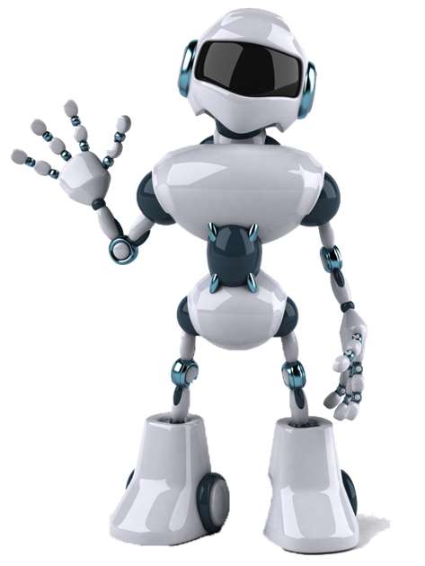
Introduction
Objective 1 (O1): Accurate Line Tracking
Robot uses lines on the floor as reference.
High position precision with IR sensors.
Objective 2 (O2): Acceleration & Braking
Smooth speed changes for safety.
Motor speed changes to prevent spillage.
Objective 3 (O3): Obstacle Detection
Detect and avoid obstacles with ultrasonic sensors.
Ensures safety and prevents accidents.

Slide 3
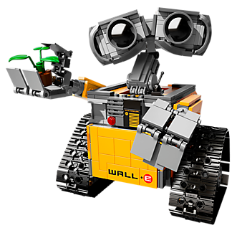
Introduction (cont.)
Summary of Project Goals
Develop a durable and effective line-following robot.
Enhance safety and efficiency in liquid transportation within restaurants and cafeterias.
Implement latest control algorithms and sensor technologies.

Slide 4

Background and Literature
Automation in Hospitality
Potential to enhance efficiency and safety.
Current State of Line-Following Robots
Extensively used in industrial applications.
Opportunity for innovative uses in hospitality.
Technological Advancements
IR sensor accuracy improvements.
Advanced control algorithms for dynamic settings.

Slide 5
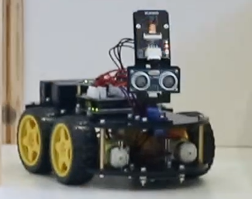
Methodology - Design and Development
Hardware Components
Microcontrollers, motors, IR sensors, ultrasonic sensors.
Chassis: Smart Robot Car Version 4 by ELEGOO.
Central Unit: Arduino Uno.
Sensor Placement
IR Sensors: bottom of the robot.
Ultrasonic Sensors: front of the robot.

Slide 6
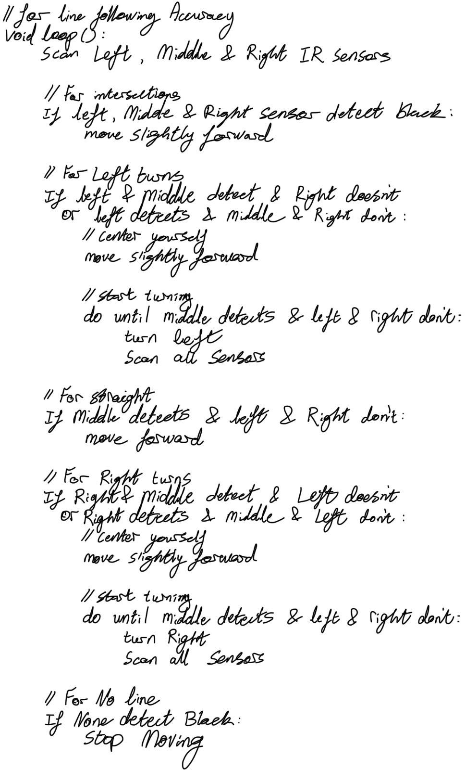
Methodology - Logical Line Following Algorithm
Sensor Setup
IR sensors positioned at the bottom to detect floor markings.
Algorithm Functionality
Robot scans inputs from sensors to follow lines accurately.
Handles intersections and turns by adjusting position and direction.
Key Steps
Move forward slightly at intersections.
Execute left and right turns based on sensor detection.
Stop if no line is detected.

Slide 7
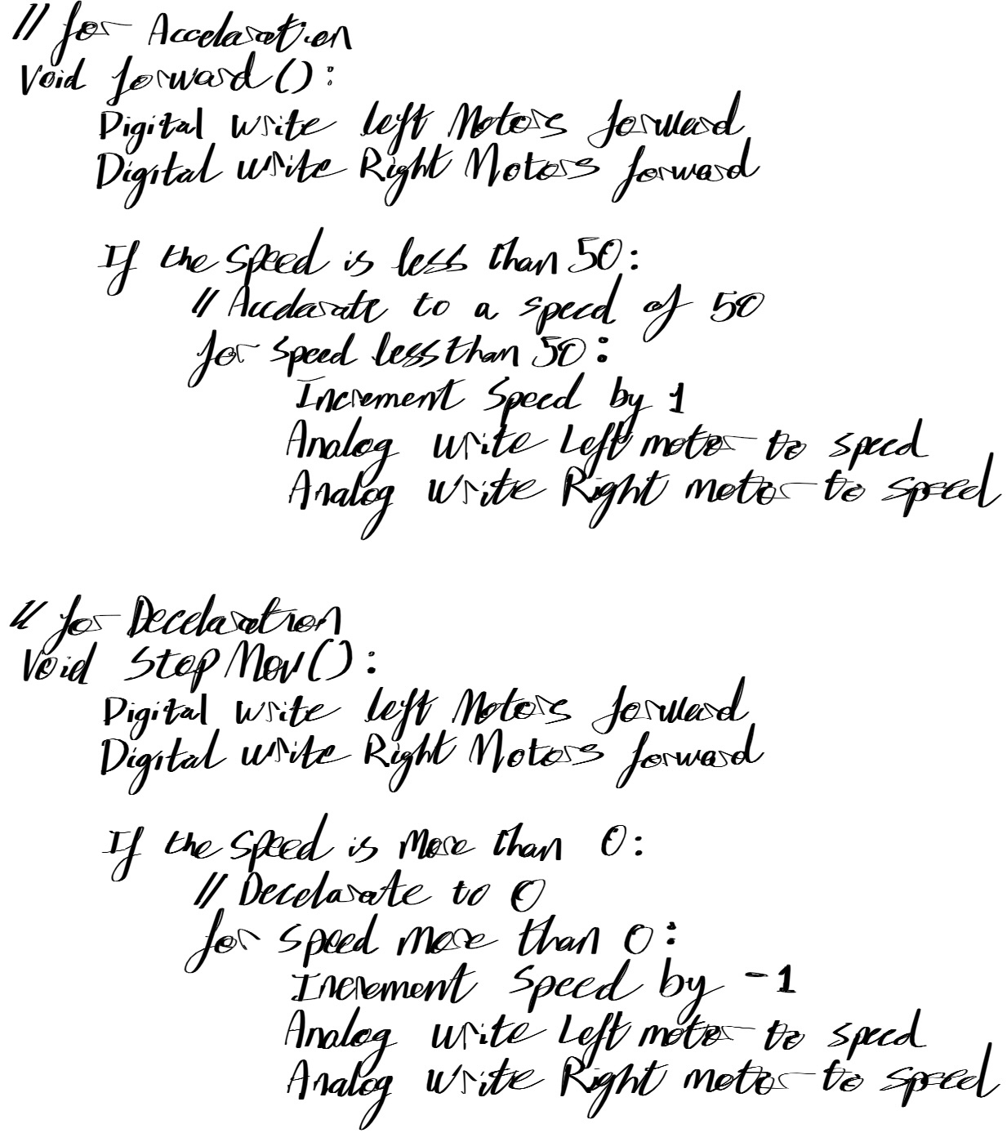
Methodology - Logical Speed Controller Algorithm
Speed Modulation
Smooth acceleration and deceleration to maintain stability.
Algorithm Functionality
Forward function: Increment speed to reach optimal levels.
Stop function: Decrement speed to stop smoothly.
Key Steps
Gradual speed adjustments for smooth transitions.
Analog write commands to control motor speeds.

Slide 8
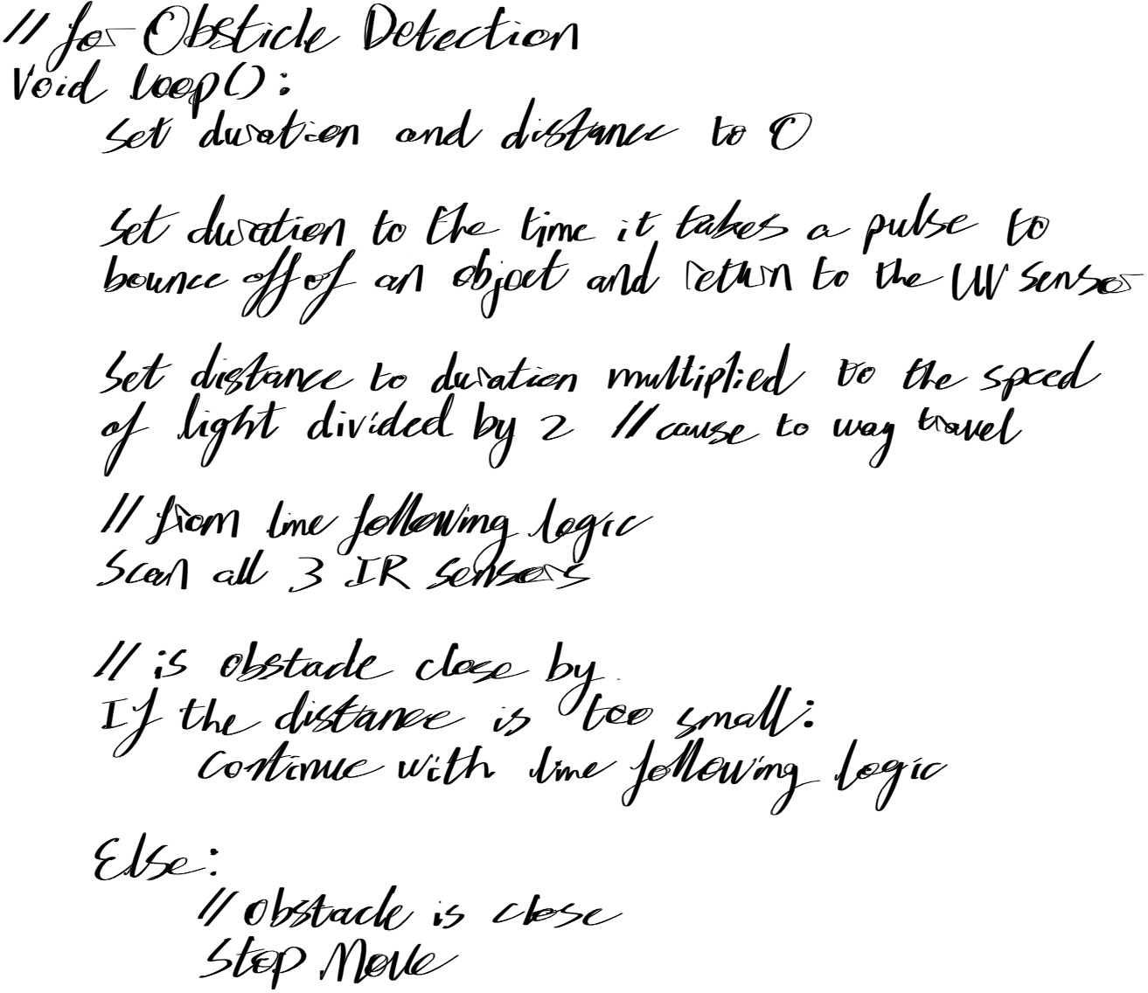
Methodology - Logical Obstacle Detection Algorithm
Ultrasonic Sensors
Placed at the front to detect obstacles.
Algorithm Functionality
Measure distance to objects using ultrasonic pulses.
Calculate distance and react to obstacles.
Key Steps
Stop or slow down if an obstacle is detected within a critical range.
Continue path once the obstacle is cleared.

Slide 9

Methodology - Implementation of the Algorithms
Line Following Algorithm
Development Process:
Initial setup with circuits to test accuracy.
Iterative refinement for precision.
Functionality:
Utilizes IR sensors for line detection.
Manages intersections, turns, and straight paths.
Obstacle Detection Algorithm
Development Process:
Tested with obstacles in the robot’s path.
Adjusted detection distance for smooth stops.
Functionality:
Uses ultrasonic sensors to measure distance.
Stops or slows down when an obstacle is detected within a critical range.
Integrated with line-following and speed control algorithms for comprehensive navigation.
Speed Controller Algorithm
Development Process:
Tested with a closed bottle to simulate open glass stability.
Adjusted algorithms for smooth speed changes.
Functionality:
Forward function for incremental speed increases.
Stop function for smooth speed decreases.
Challenges in precision during turns and stability in movements.

Slide 10
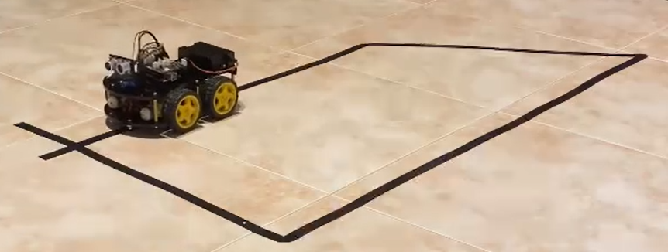
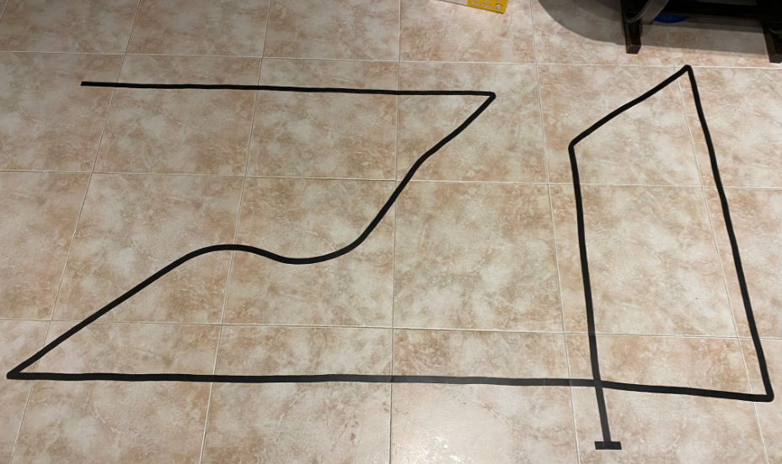
Testing and Observations - Line Following Algorithm
Testing Setup
Black electrical tape on tiled floor to simulate real-world conditions.
Box-shaped circuit with varied angles (right-angle turns, obtuse-angled turns, intersections).
Results
Successfully navigated complex pathways.
High precision in detecting and following lines.
Effective handling of different circuit designs, including sharp and curved lines.

Slide 11
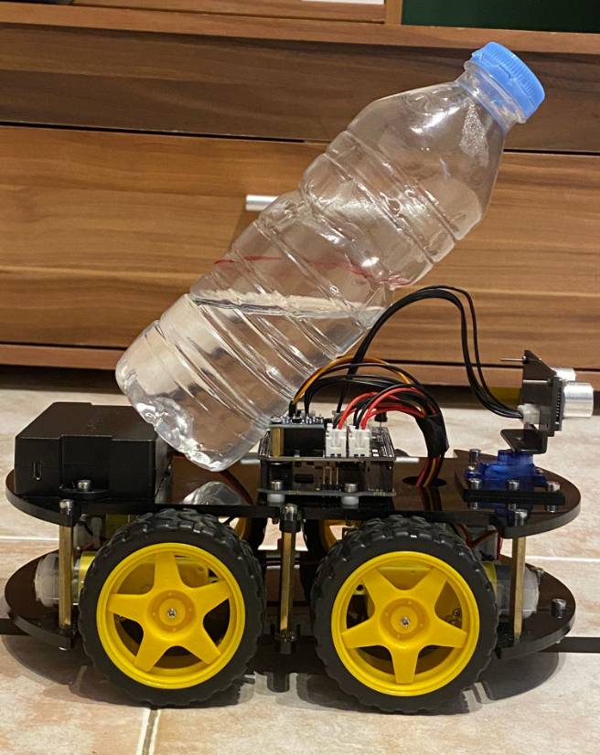
Testing and Observations - Speed Controller Algorithm
Testing Setup
Closed bottle with red line marker to simulate liquid level.
Observed water stability during movements.
Results
Successful forward movements with stable liquid level.
Smooth acceleration and deceleration without spillage.
Challenges observed during curved turns, indicating need for further refinement in motor control.

Slide 12
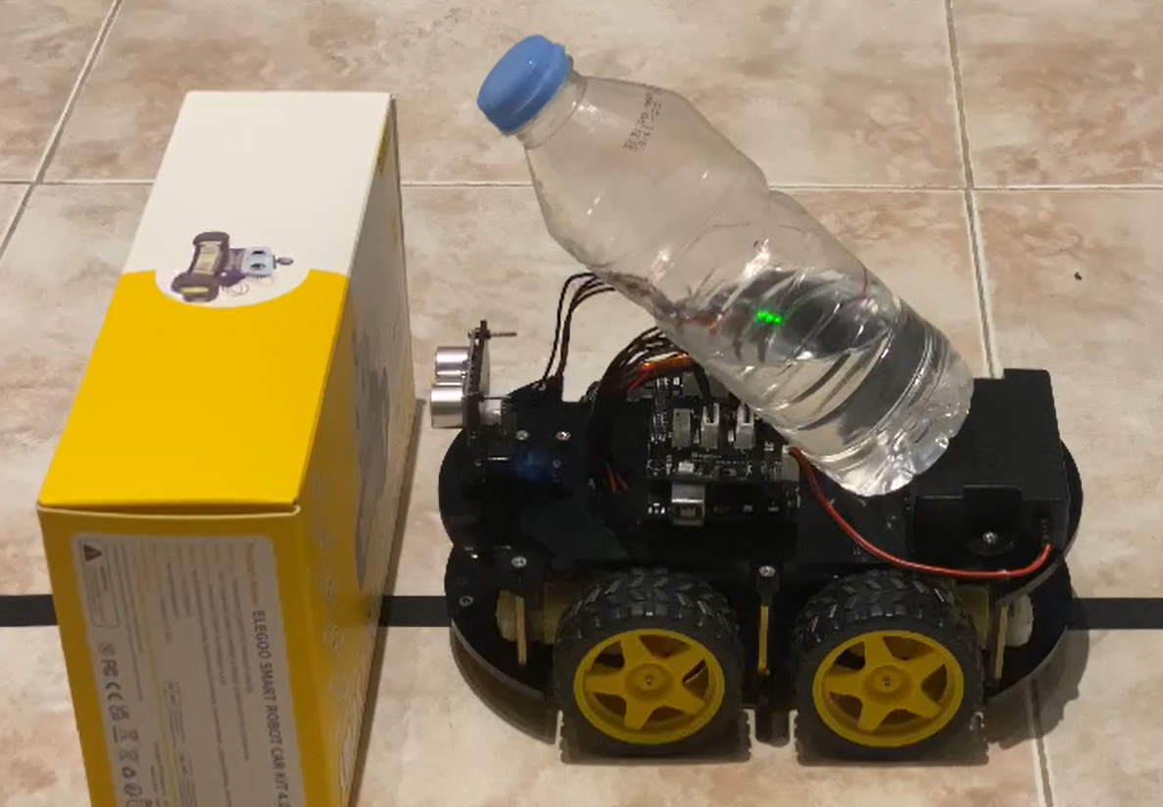
Testing and Observations - Obstacle Detection Algorithm
Testing Setup
Placed obstacles in the robot’s path to assess response.
Measured optimal distance for detection and stopping.
Results
Effective obstacle detection and avoidance.
Smooth deceleration and stops before reaching obstacles.
Maintained liquid stability during abrupt stops.
Demonstrated reliable performance in preventing collisions.

Slide 13

Testing and Observations - Video

Slide 14

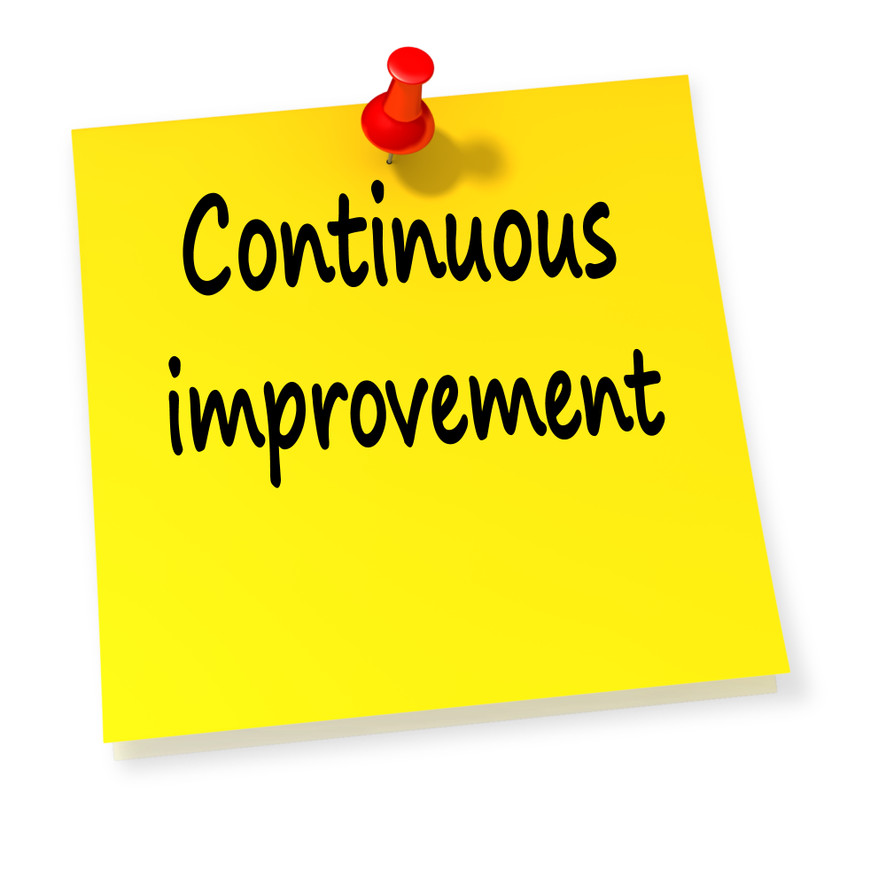
To Conclude - Future Works and Impacts
Future Works
Enhance motor control for better performance in curved paths.
Integrate advanced sensor fusion and machine learning for improved obstacle detection.
Future Impacts
Potential to significantly improve efficiency and safety in hospitality settings.
Contributes valuable knowledge to the field of service robotics.

Slide 15
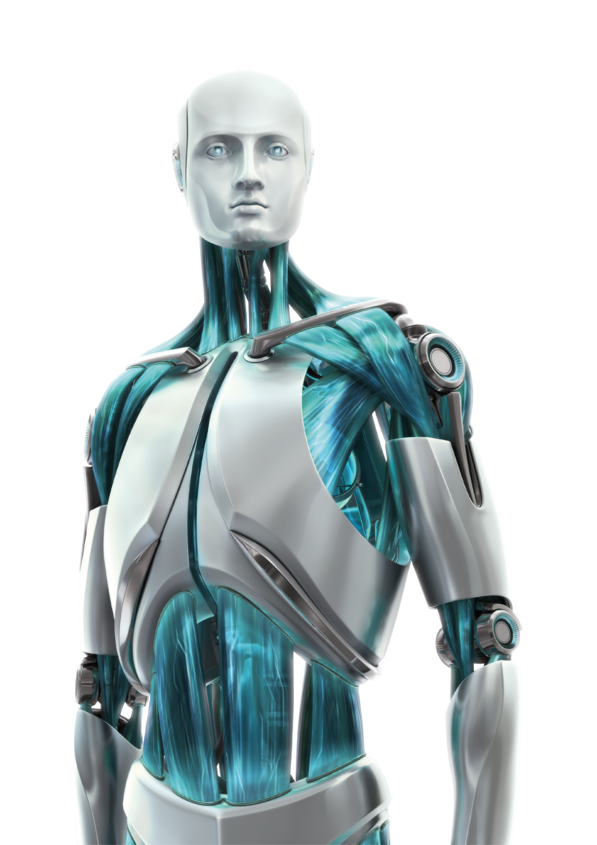
To Conclude - Successes and Key Achievements
Project Success
Developed a functional line-following robot for liquid transportation in restaurants and cafeterias.
Achieved high accuracy in line tracking, smooth acceleration and braking, and effective obstacle detection.
Key Achievements
Objective 1: Accurate Line Tracking
Successfully navigated complex pathways with high precision using IR sensors.
Objective 2: Acceleration & Braking
Maintained stability and prevented spillage during movements with smooth speed control algorithms.
Objective 3: Obstacle Detection
Ensured safe navigation by detecting and avoiding obstacles using ultrasonic sensors.

Slide 16
Thank you!
Good Day :-)

